Slide 1
Describing a translation
Transformations

Slide 2
how to use Oak lessons

Slide 3
I can understand the minimum information required to describe a translation.

Slide 4
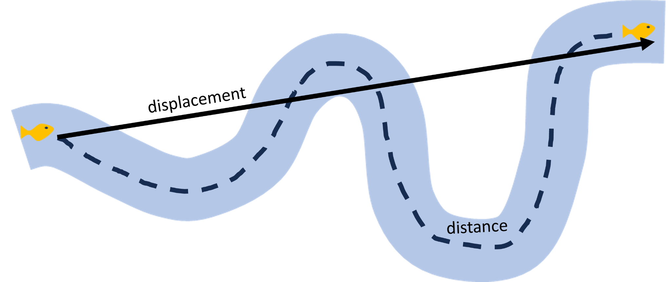
Displacement is the distance from the starting point when measured in a straight line.
A vector can be used to describe a translation. (You will be finding out about vectors during this lesson).

Slide 5

Describing a translation
Describing a translation
Vector notation

Slide 6
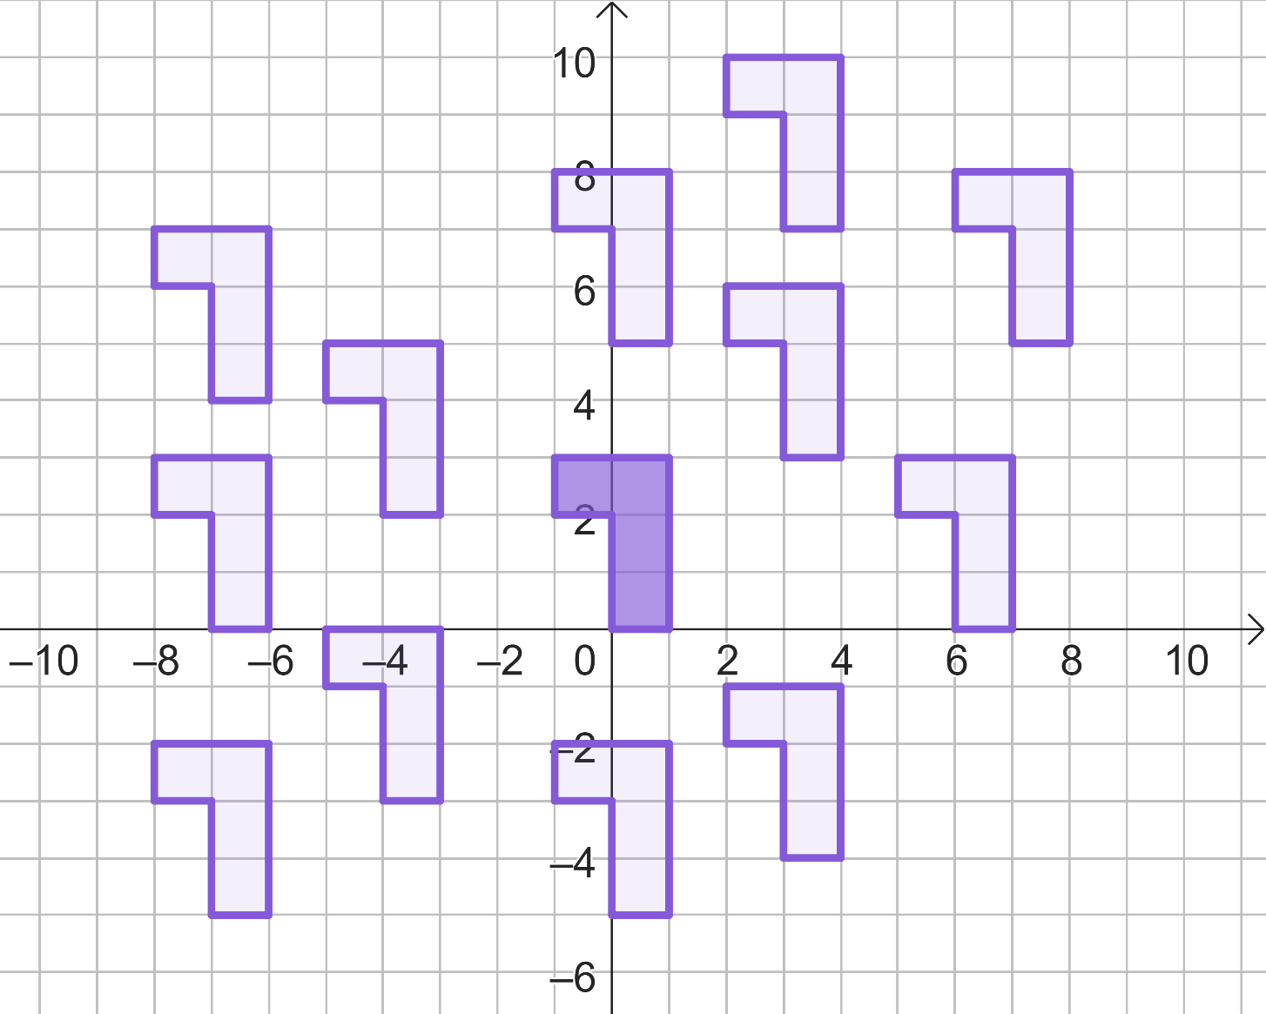
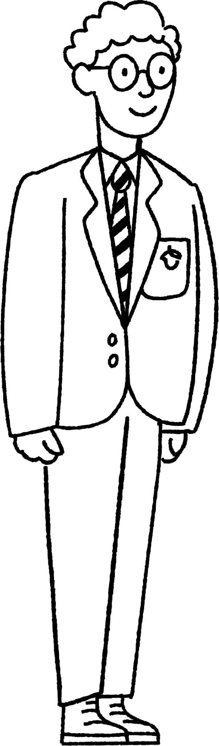
Describing a translation
All of these shapes are translations from the object (A).
Alex has chosen one of the shapes. Through his descriptions we are going to try and locate it.
A

Slide 7
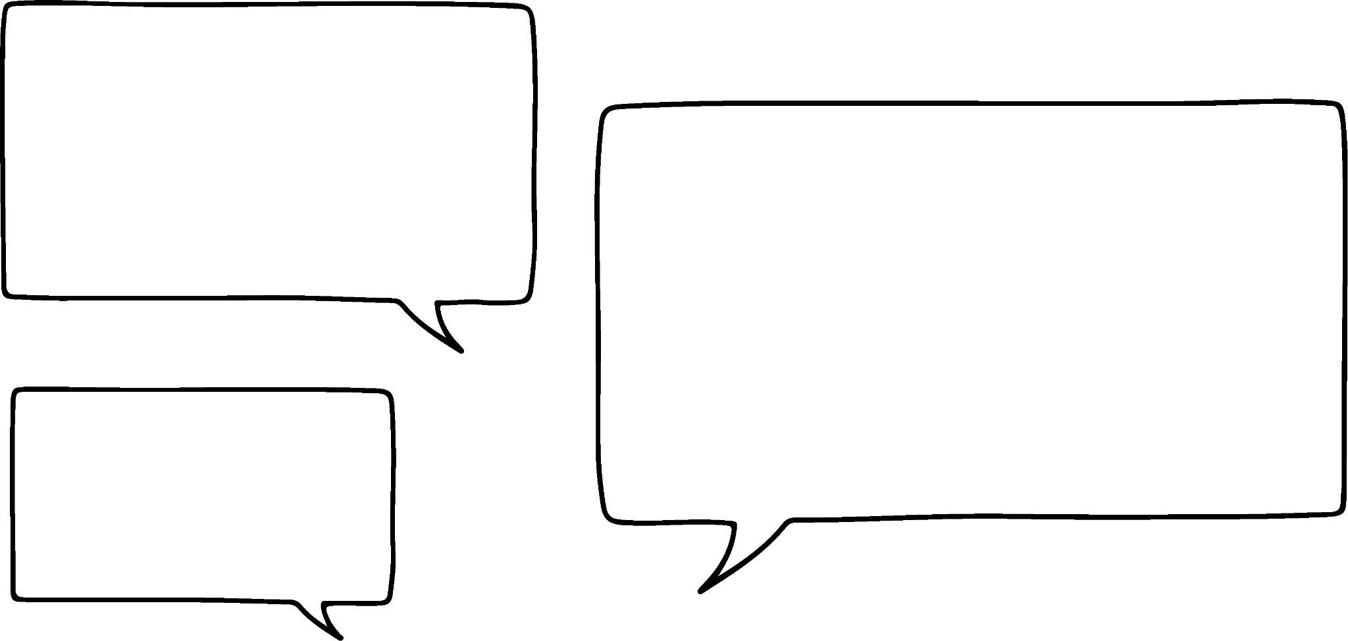
Describing a translation
A has moved across and up.
A

Slide 8
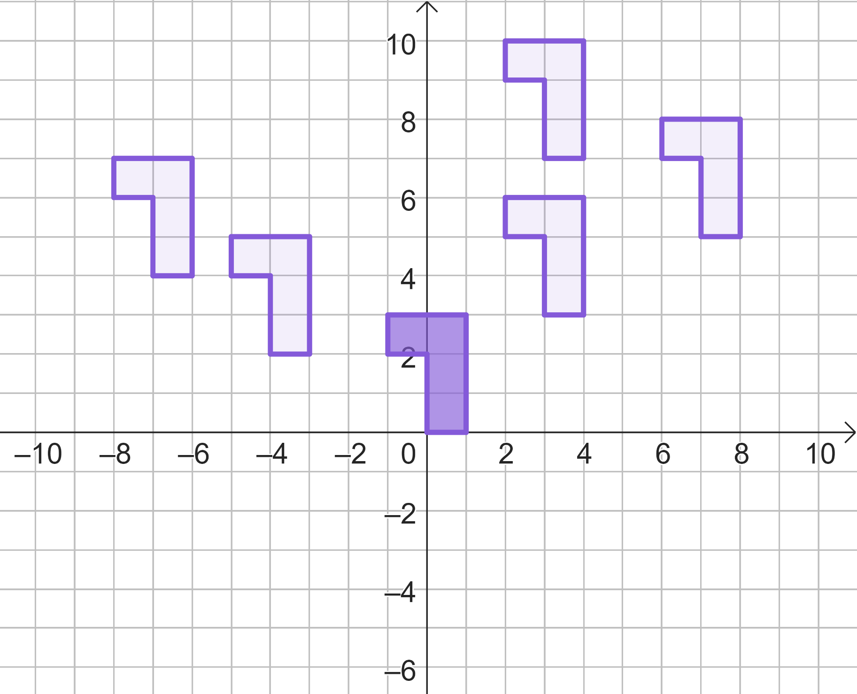
Describing a translation
A has moved across and up.
A

Slide 9
Describing a translation
A has moved right and up.
A

Slide 10
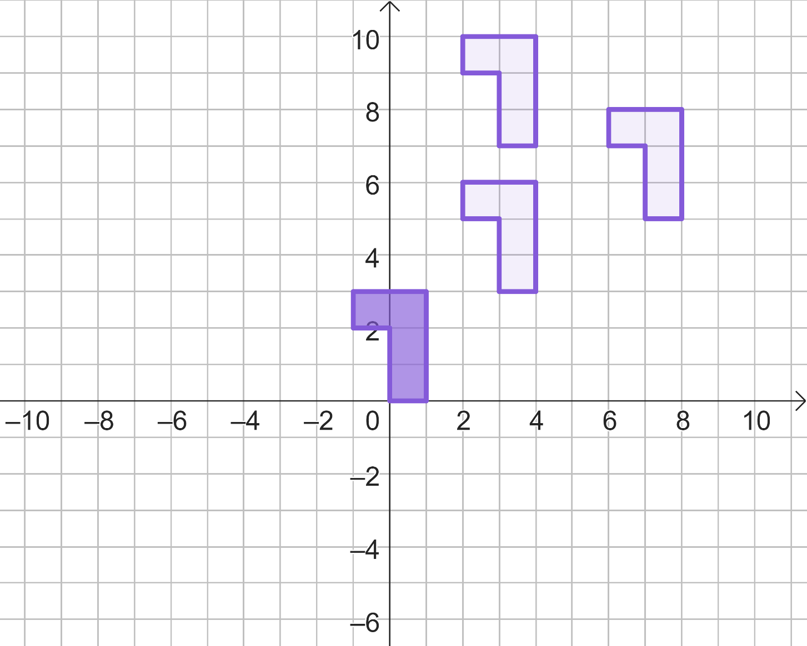
Describing a translation
A has moved right and up.
A

Slide 11
Describing a translation
A has moved right by 3 and up.
A

Slide 12
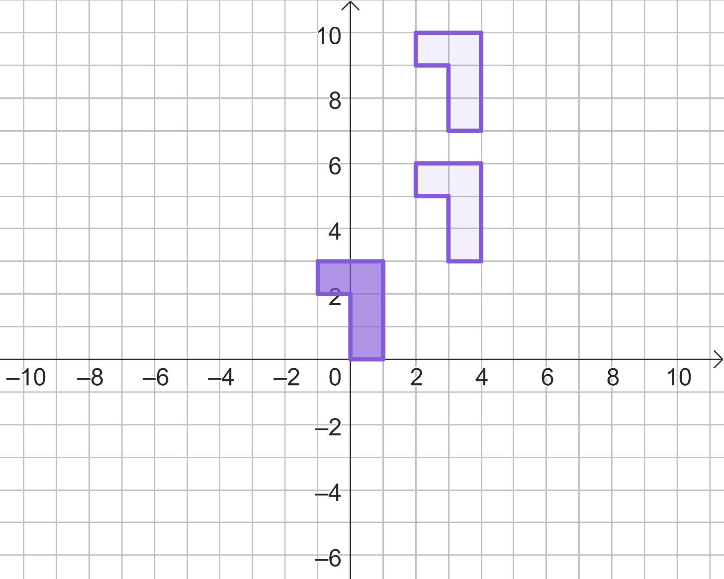
Describing a translation
A has moved right by 3 and up.
A

Slide 13
Describing a translation
A has moved right by 3 and up by 7.
A

Slide 14
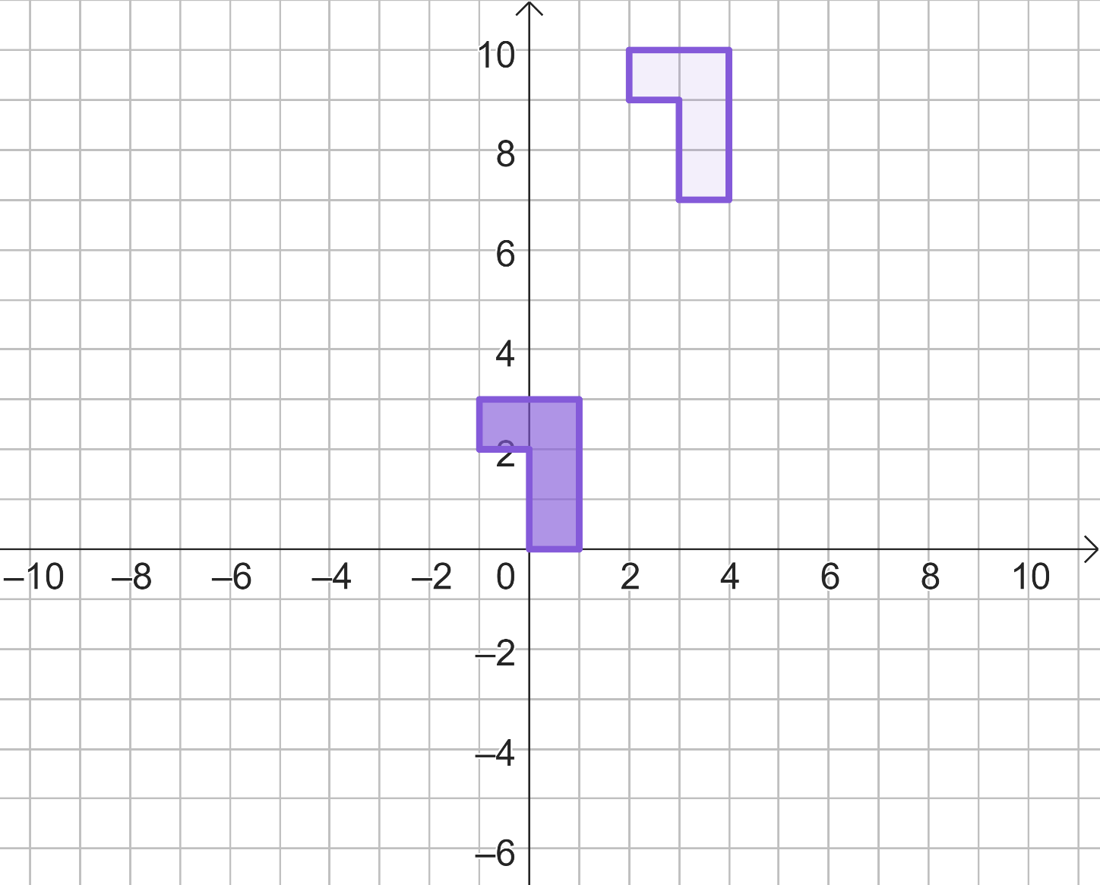
Describing a translation
A has moved right by 3 and up by 7.
A

Slide 15
Describing a translation
If Alex had said only the last description would we have known the correct image?
A has moved right by 3 and up by 7.
A
Yes, this would lead us to the correct image.

Slide 16
Describing a translation
A good description of a translation should state:
that it has been translated (rather than moved/slid)
whether it has been translated left or right and how far (the horizontal displacement)
whether it has been translated up or down and how far (the vertical displacement).

Slide 17
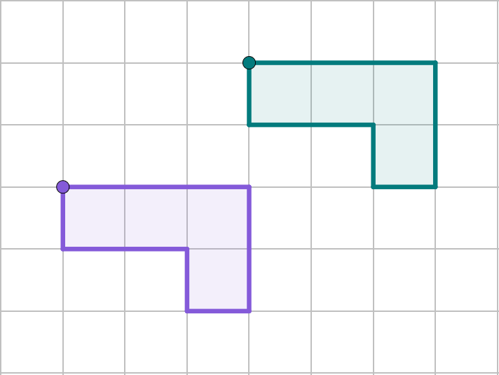
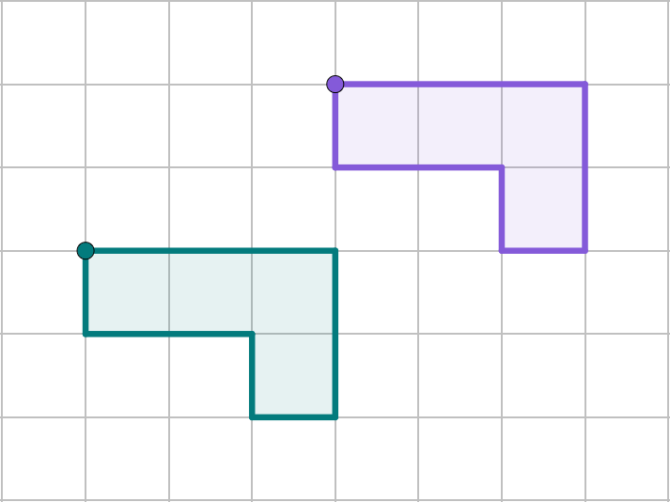
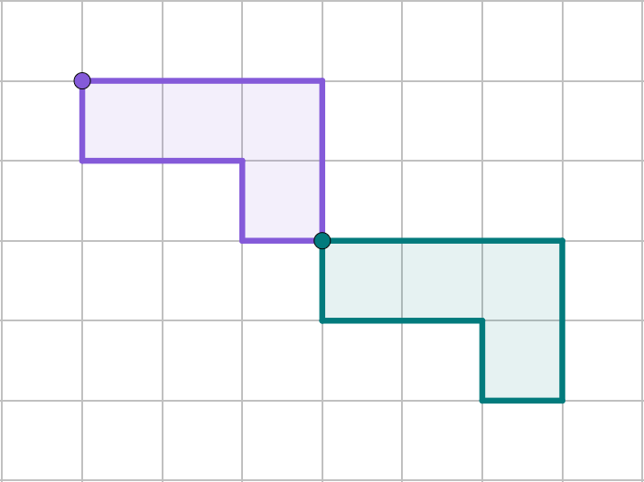

Describing a translation
Choose the figure that matches the description “The object has been translated left by 3 squares and down by 2 squares”.
A′
A
A
A
A′
A′

Slide 18
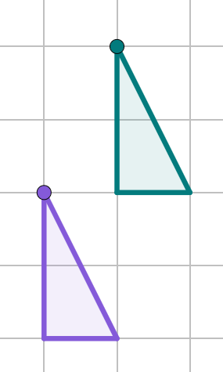
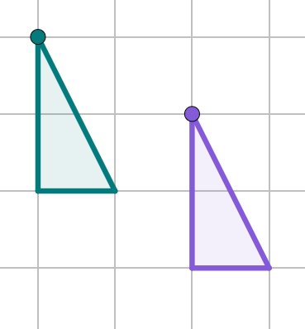
Describing a translation
1) Complete the description for each image.
A′
a)
b)
A′
A
A
The object has been translated . by squares and . by squares.
The object has been translated . by squares and . by squares.

Slide 19

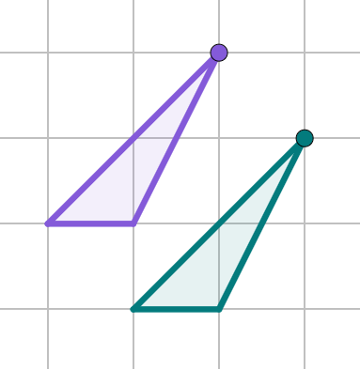
Describing a translation
2) Izzy has given an incomplete description of a translation.
Write a full description for the translation shown.
The shape has moved across and down.
P
P′

Slide 20
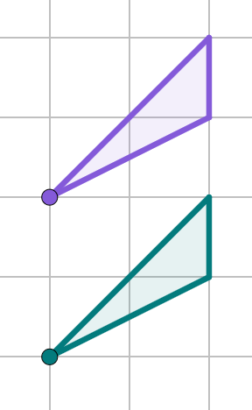
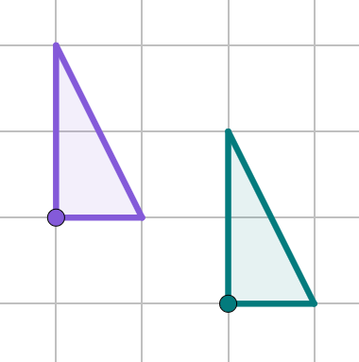
Describing a translation
Write full descriptions for the translations.
a)
b)
T′
T
R
R′

Slide 21
Describing a translation
Complete the description for each figure.
A′
b)
A′
A
A
The object has been translated . by squares and . by squares.
The object has been translated . by squares and . by squares.
right
1
left
2
up
2
up
1

Slide 22
Describing a translation
2) Izzy has given an incomplete description of a translation.
Write a full description for the translation shown.
The shape has moved across and down.
P
P′
The object has been translated right by 1 square and down by 1 square.

Slide 23
Describing a translation
Write full descriptions for the translations.
a)
b)
T′
T
R
R′
The object has been translated left by 2 squares.
The object has been translated right by 2 squares and down by 1 square.

Slide 24
Describing a translation
Describing a translation
Vector notation

Slide 25
Vector notation
When a length is translated it remains unchanged, but in a different position.
Consider the distance between two numbers, such as 2 and 5.
0
1
2
3
4
5
6
7
8
9
10
11
12
13
14
15
If we add 5 to both numbers, the distance between them remains unchanged.
0
1
2
3
4
5
6
7
8
9
10
11
12
13
14
15

Slide 26
Vector notation
When a length is translated it remains unchanged, but in a different position.
Consider the distance between two numbers, such as 2 and 5.
0
1
2
3
4
5
6
7
8
9
10
11
12
13
14
15
If we add 5 to one number and 3 to the other, the distance between them would change.
0
1
2
3
4
5
6
7
8
9
10
11
12
13
14
15

Slide 27
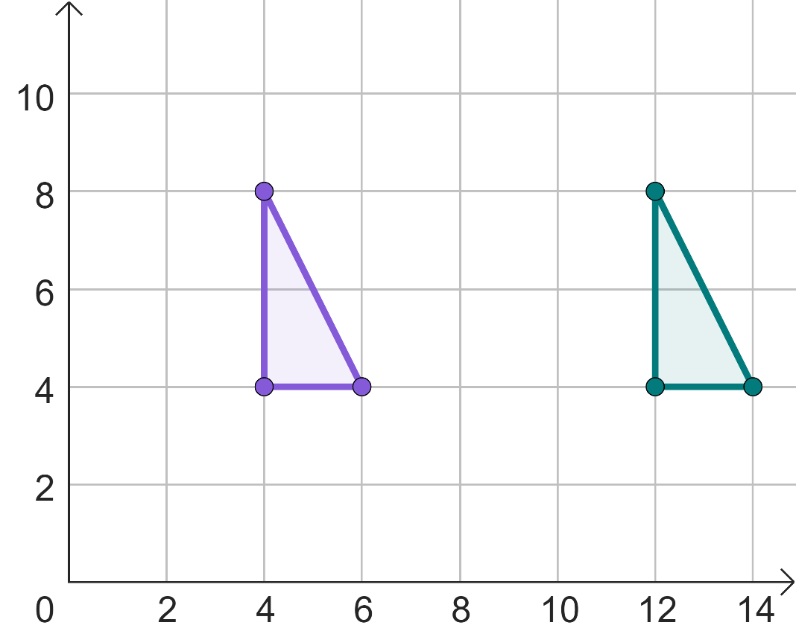
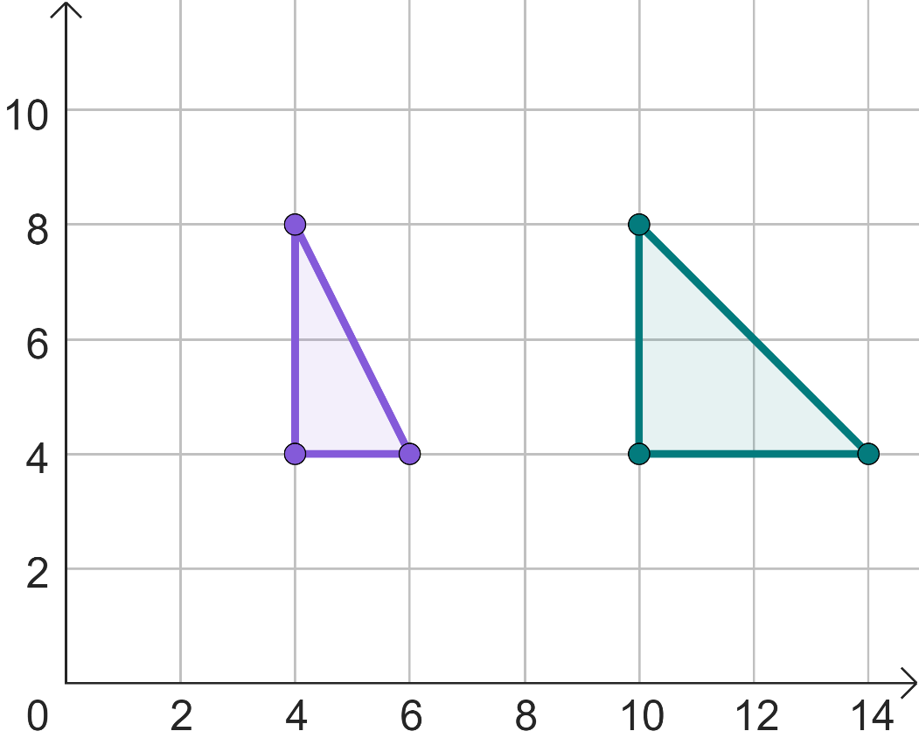
Vector notation
Similarly, if a shape is translated, all vertices need to move by the same amount for it to be congruent.
(4, 8)
(12, 8)
(4, 8)
(10, 8)
(6, 4)
(14, 4)
(6, 4)
(14, 4)
(4, 4)
(12, 4)
(4, 4)
(10, 4)
Translation
Not a translation

Slide 28
Vector notation
By looking at the object and image coordinates, we can check to see if a translation has taken place.
Object coordinate
Image coordinate
(2, 5)
(2, 7)
(3, 6)
(3, 8)
(4, 5)
(4, 7)
In this case, the y-coordinate of each has increased by 2, so the triangle has been translated up by 2 units.

Slide 29
Vector notation
Has a translation taken place given these coordinates?
Object coordinate
Image coordinate
(3, 0)
(1, 1)
(5, 1)
(3, 2)
(6, 5)
(4, 6)
Yes, the shape has translated left by 2 units and up by 1 unit.

Slide 30
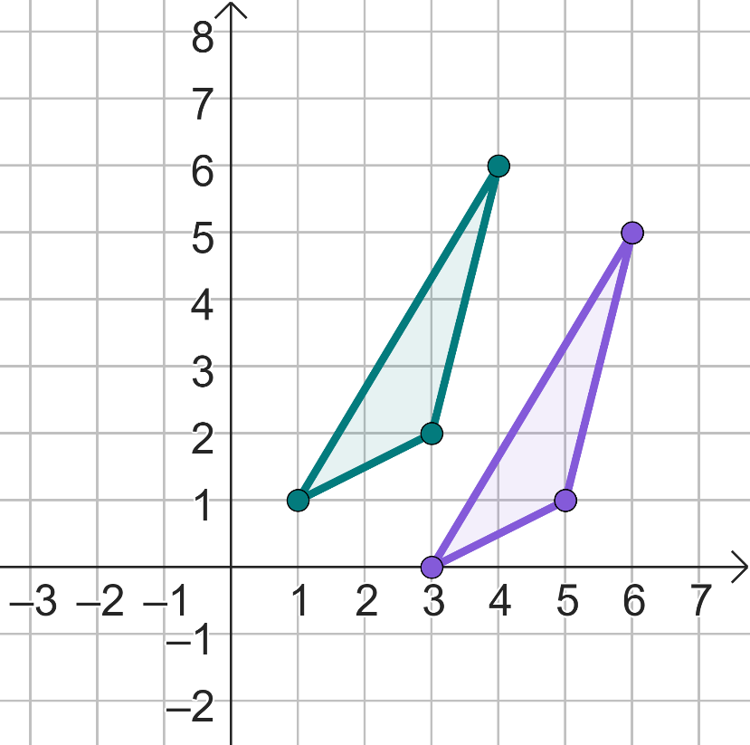

Vector notation
The description for this transformation is:
Moves left by 2 squares
Moves up by 1 square
Andeep

Slide 31

Vector notation
You do not need all the words.
Translated
-2
+1
Jun

Slide 32
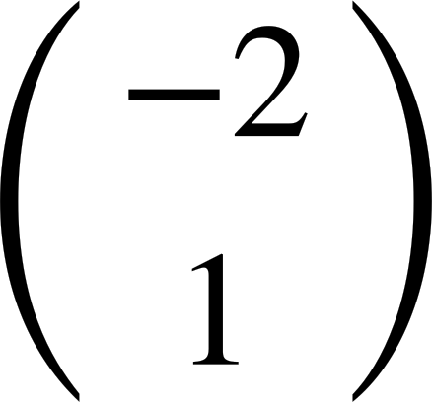

Vector notation
You only need this:
Translated by
Sofia

Slide 33
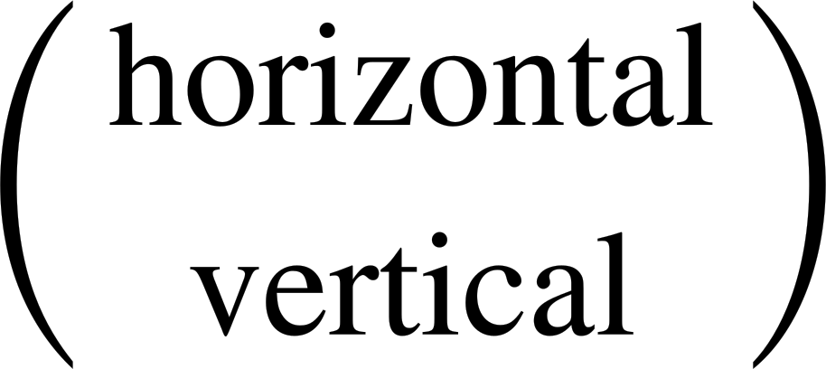
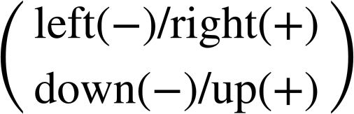
Vector notation
Column vectors have the general form

Slide 34
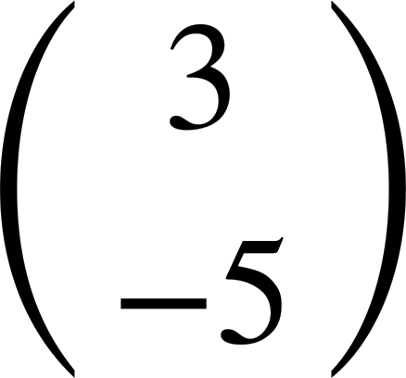
Vector notation
Translated by means
up by 3 and left by 5
left by 3 and down by 5
right by 3 and down by 5

Slide 35
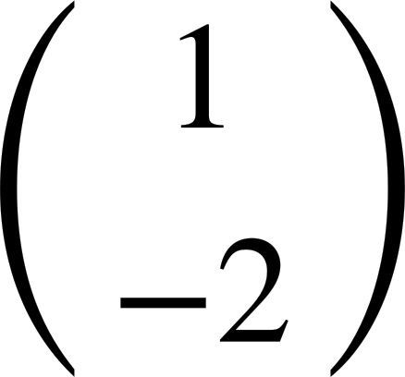
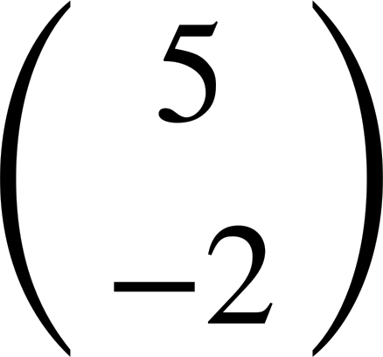
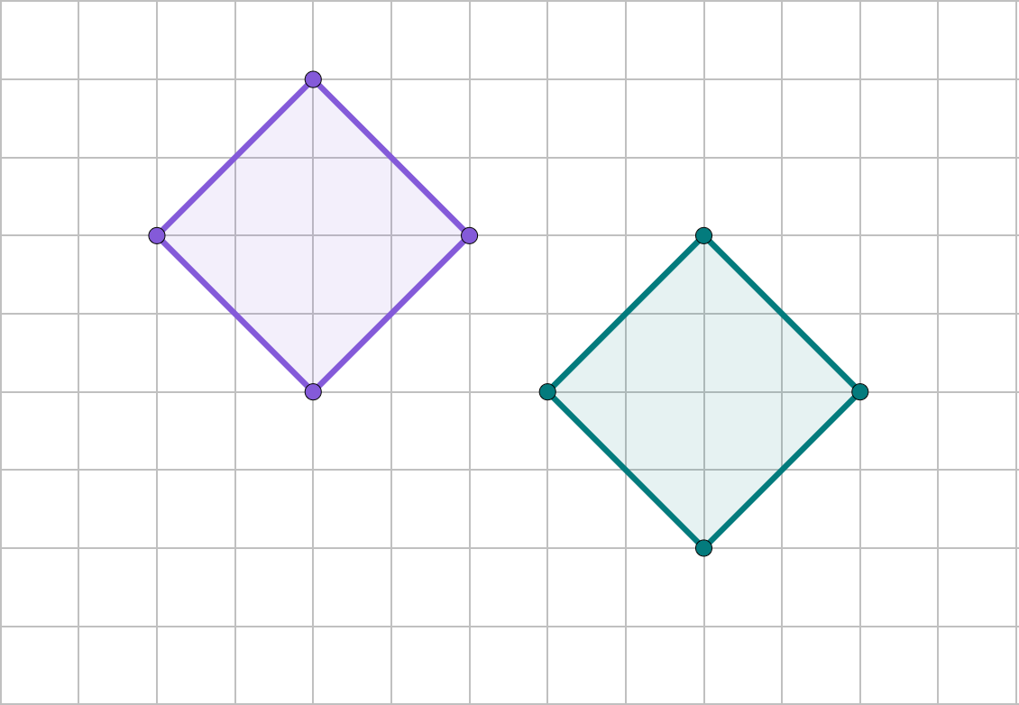

Vector notation
The object has been translated by
The object has been translated by
A
A′
Laura
C
Izzy
C′
You must count between corresponding vertices.
It doesn’t matter which pair.

Slide 36
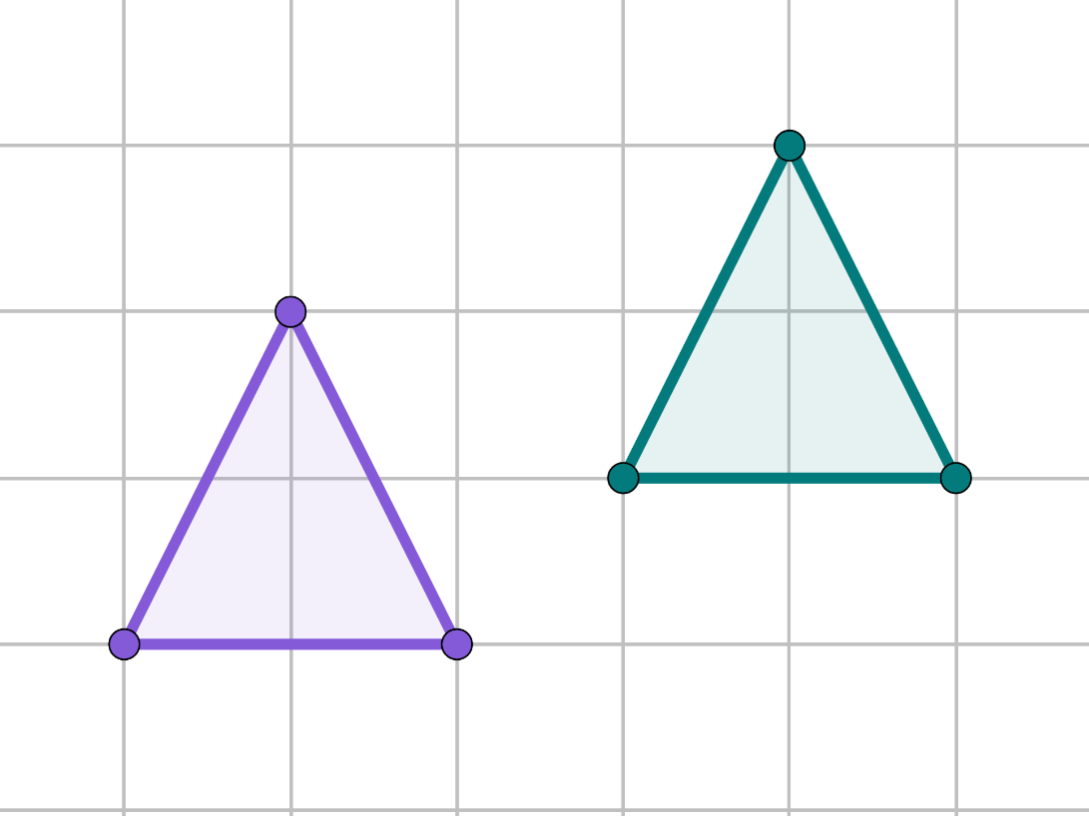
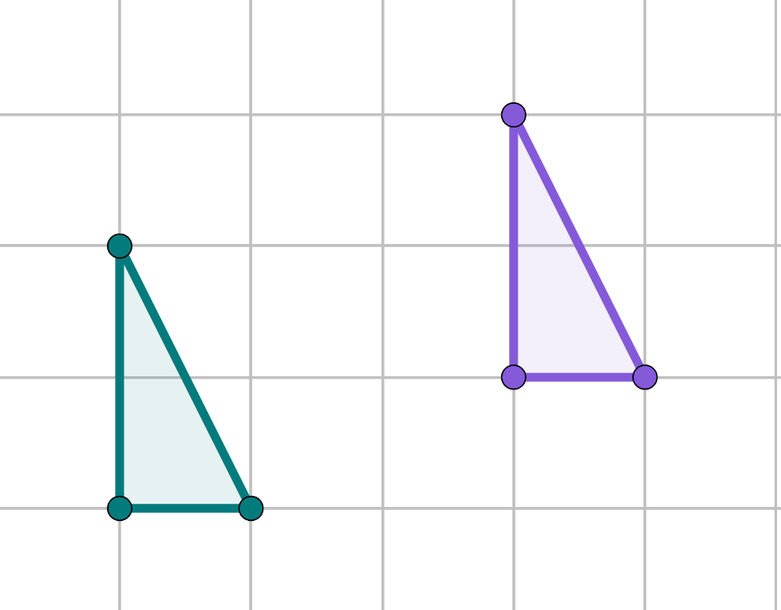
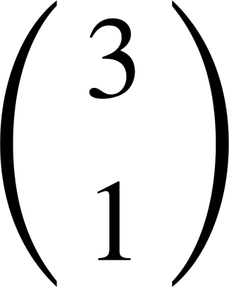
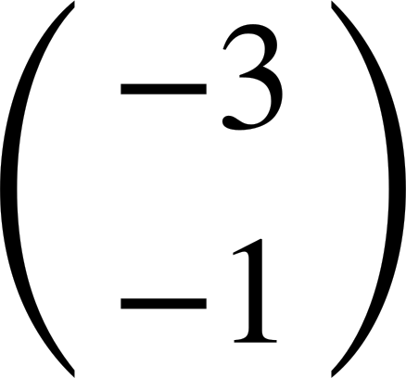
Vector notation
Describe the transformation.
Describe the transformation.
P′
X
P
X′
R′
Q′
Y
Z
Q
R
Y′
Z′
Translated by
Translated by

Slide 37
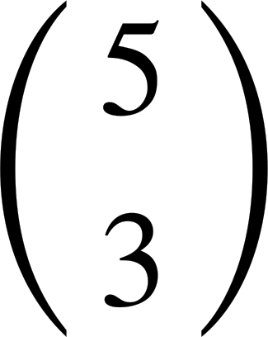
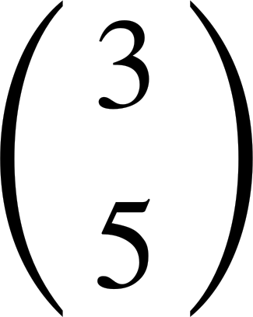
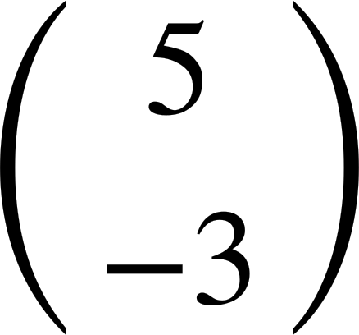
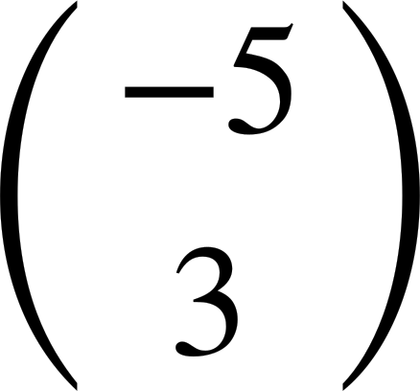
Vector notation
Match the description to the column vector.
Translated left by 5 and up by 3 units.
Translated right by 3 and up by 5 units.
Translated right by 5 and up by 3 units.
Translated right by 5 and down by 3 units.

Slide 38
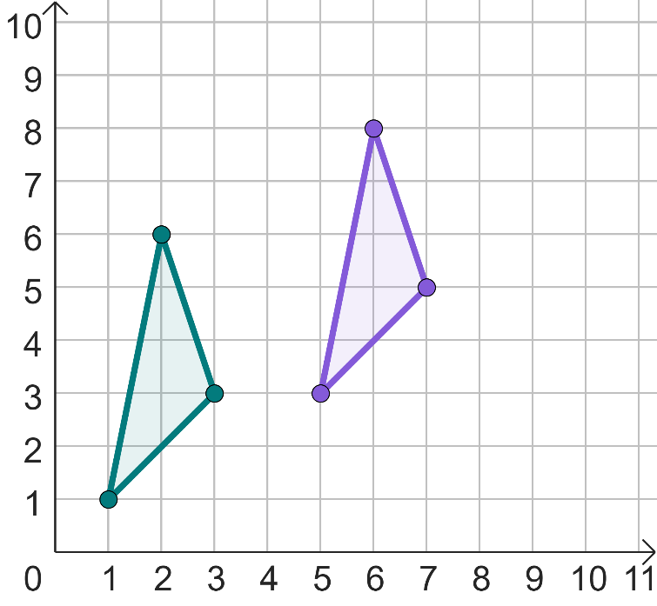
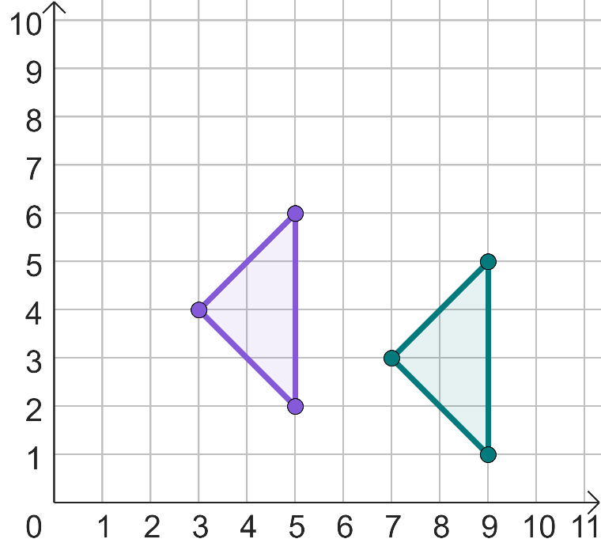
Vector notation
Write a description using a column vector for each translation.
a)
b)
I
I′
J
J′

Slide 39
Vector notation
Given the coordinates of the object and image, describe the translation.
Object coordinate
Image coordinate
b)
Object coordinate
Image coordinate
(-2, 2)
(3, 1)
(2, 6)
(-1, 8)
(-2, -2)
(3, -3)
(4, 3)
(1, 5)
(1, -2)
(6, -3)
(5, 6)
(2, 8)

Slide 40
Vector notation
Match the description to the column vector.
Translated left by 5 and up by 3 units.
Translated right by 3 and up by 5 units.
Translated right by 5 and up by 3 units.
Translated right by 5 and down by 3 units.

Slide 41
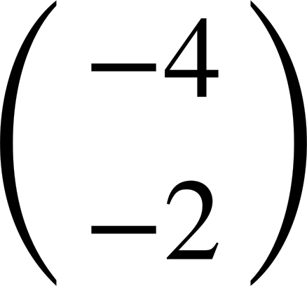
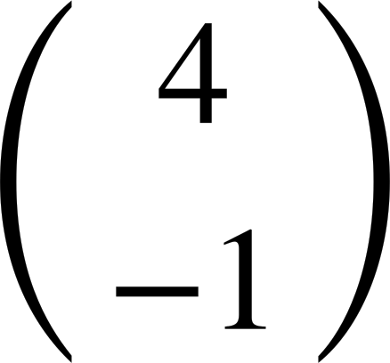
Vector notation
Write a description using a column vector for each translation.
a)
b)
I
I′
J
J′
Translated by
Translated by

Slide 42
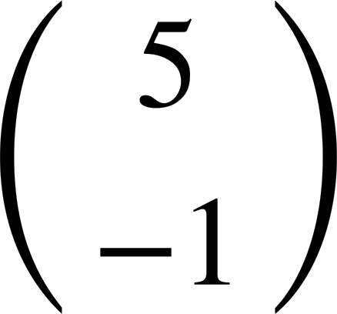
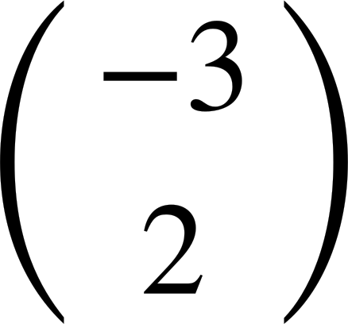
Vector notation
3) Given the coordinates of the object and image, describe the translation.
a)
Object coordinate
Image coordinate
b)
Object coordinate
Image coordinate
(-2, 2)
(3, 1)
(2, 6)
(-1, 8)
(-2, -2)
(3, -3)
(4, 3)
(1, 5)
(1, -2)
(6, -3)
(5, 6)
(2, 8)
Translated by
Translated by

Slide 43
Describing a translation
To describe a translation, you must give both direction and distance from the start. This is known as displacement.
A column vector is a succinct way to describe a translation.

Slide 44

© Oak National Academy 2023.
Produced in partnership with Mathematics in Education and Industry.
Licensed on the Open Government Licence v3.0, except where otherwise stated. See Oak terms and conditions.

